Slide 1

How to sign the Risk Assessments uploaded to the web.

Slide 2
Website link below
ICRA Risk Assessment

Slide 3

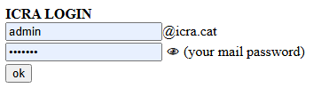
If you are staff ICRA
User: The name you use in your ICRA email (Ex. ncaceres)
Password: The password you use in your ICRA email

Slide 4
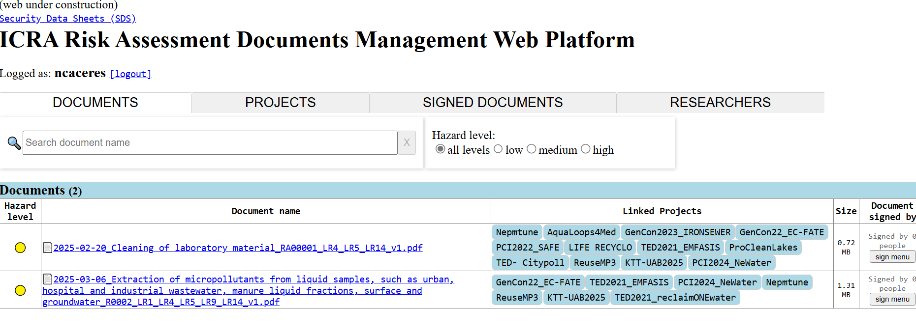
View of the main page of the website.

Slide 5
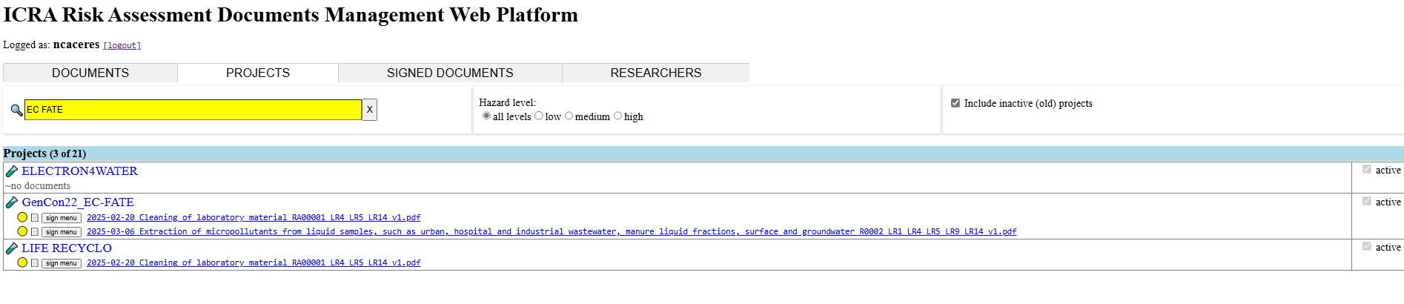
Go to the tab that says Projects.
Search for the names of the projects you're working on.

Slide 6
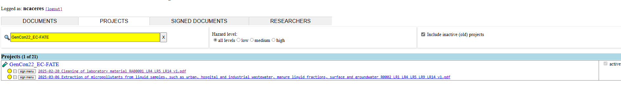
Now, read all the Risk Assessments related to your projects.
To read them, download the document in PDF, sign it with the electronic signature if you have one and save it.
If you don’t have electronic signature, sign it manually, scan it in PDF format and save it.
Press the button on the right to sign (sign menu)

Slide 7
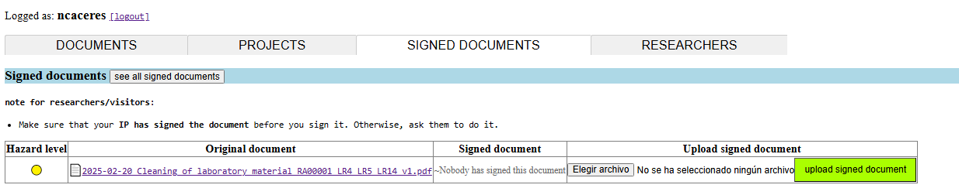
Press choose file

Slide 8
Press choose file
Press “choose file," and it will give you the option to select the signed file from were
you have saved it.

Slide 9

Press upload signed document
Press “upload singed document” and the document will be added to the website

Slide 10
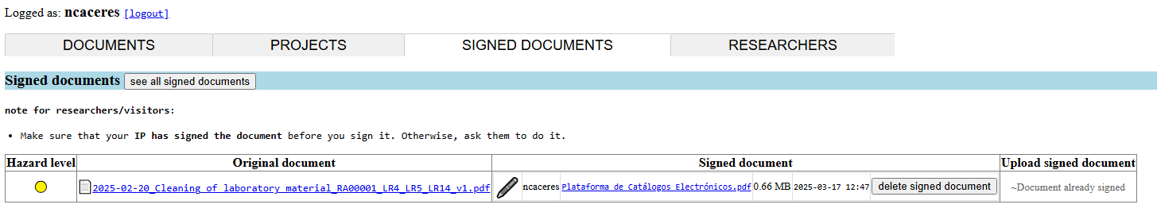
After upload signed document
In the signed document cell, the name of the person who has signed the document will appear, and next to it, the document with the signature in PDF format.
If, for any reason, you made a mistake when uploading the document, you will have the option to delete the incorrect using the button “delete signed document” and upload the correct one again.

Slide 11
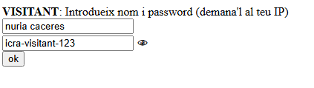
If you are a visitor at ICRA
User: Put your first and last name in lowercase.
Password: The password will be icra-visitant-123

Slide 12
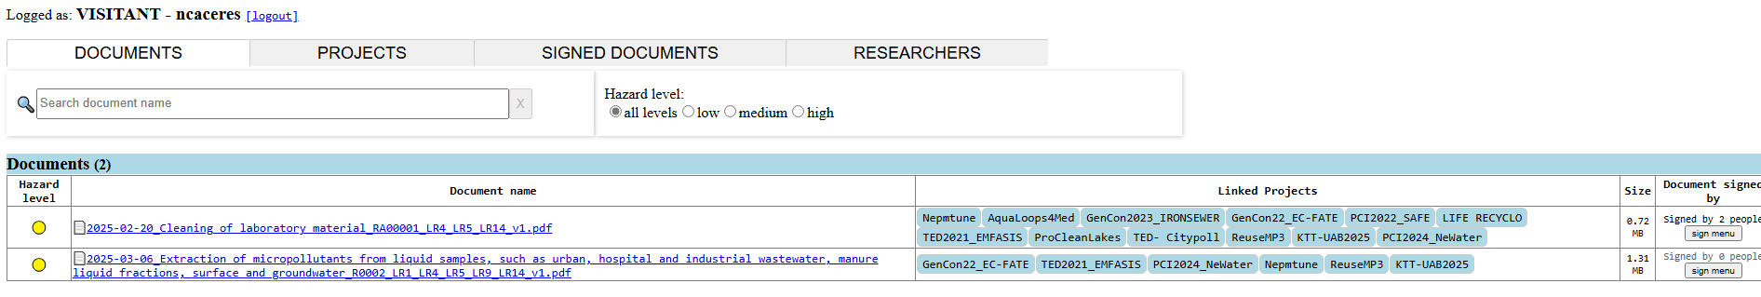
View of the main page of the website.

Slide 13
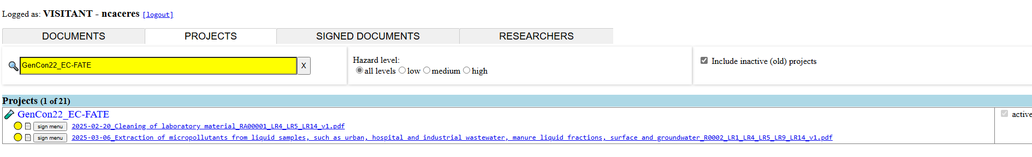
Go to the tab that says Projects.
Search for the names of the projects you're working on.

Slide 14
Now, read all the Risk Assessments related to your work in ICRA.
Your PI will indicate which project(s) you will work on and which Risk Assessment you need to read before starting to work.
To read them, download the document in PDF, sign it with the electronic signature if you have one and save it.
Print and sign it manually, scan it in PDF format and save it.
Press the button on the right to sign (sign menu)

Slide 15
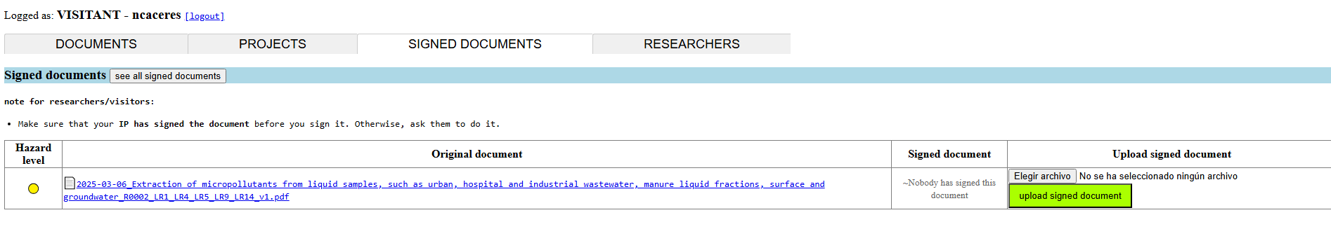
Press choose file
Press "Choose file," and it will give you the option to select the signed file from where you have saved it.

Slide 16
Press upload signed document
Press “Upload singed document” and the document will be added to the website

Slide 17
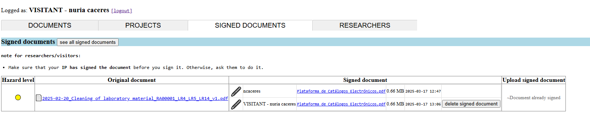
After upload signed document
In the signed document cell, the name of the person who has signed the document will appear, and next to it, the document with the signature in PDF format.
If, for any reason, you made a mistake when uploading the document, you will have the option to delete the incorrect using the button “delete signed document” and upload the correct one again.

Slide 18
If you have any doubt, please check the link below.
Resumen: Seminari informatiu: el nou protocol de Risk Assessmentmiércoles, 15 de enero

Slide 19
THANK YOU

